Slide 1
Azure API Management(APIM)
05.07.2023

Slide 2
Introduction

Slide 3
Objective
The main objective of Azure API Management(APIM) is to provide an interface for both developers and providers to functions such as use, manage, monitor, and log the API.
Develop step-by-step documentation: Create a detailed guide that covers the essential functionalities of APIM, including request logs, message search, error handling, and certificate management.
Design a training presentation: Develop a concise and visually appealing presentation to deliver hands-on training on APIM usage, featuring screenshots and examples for practical understanding.

Slide 4
Benefits
The some benefits of APIM for JTI are following:
Proactive determination of data exchange issues
Log for analysis and SLO validation

Slide 5
Overview
API Management can be considered as a middleware that processes anything going to and from CR.
In the meantime it not only can monitor and log the data exchanges but it can also help with management aspects such as limiting an IP range with a whitelist, automated test to API, etc.

Slide 6
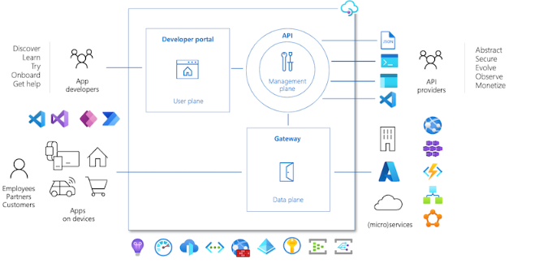
Components

Slide 7
API Gateway
Where all the magic happens. This is the middleware that catches requests from clients and forwards them to the backend. This is the part where the APIM collects data and processes it. We are mainly using tools located here.
Management Plane
Admin management platform for APIM. It provides functionalities like APIM settings, managing users, defining API schemas, and packaging them to products etc.
Developer Portal
This is a platform for developers(clients). They can read API documentation, call API endpoints, get an account to get API keys, etc.

Slide 8
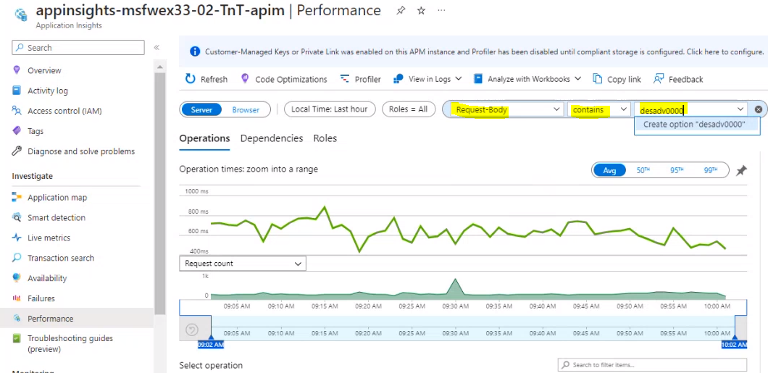
How to search messages
Select 'Performance' tab in the left Navigation Menu.

Slide 9
2. Select you filters at the top. The most important ones could be 'Time range' and 'Request-Body' (with the condition 'Contains'):

Slide 10
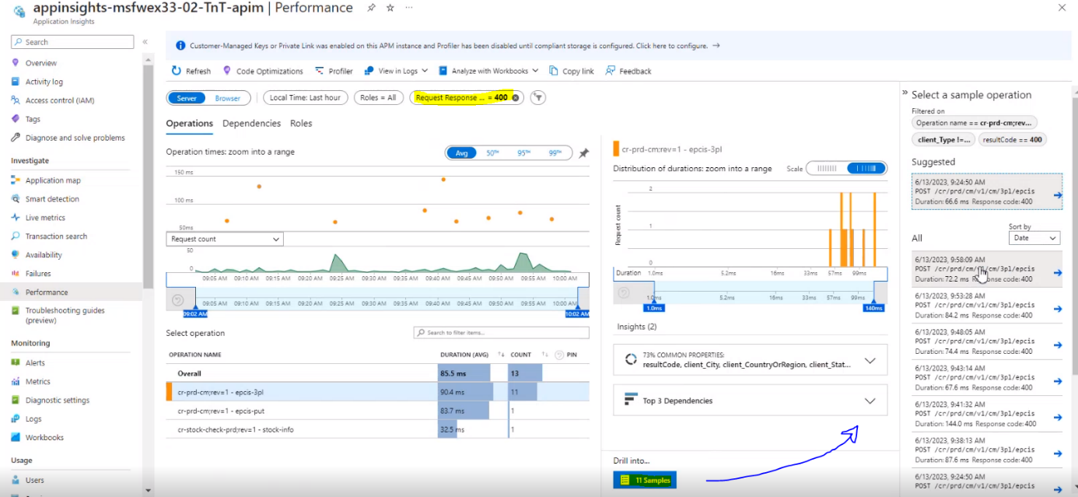
3. Review the search result after applying the filters.

Slide 11
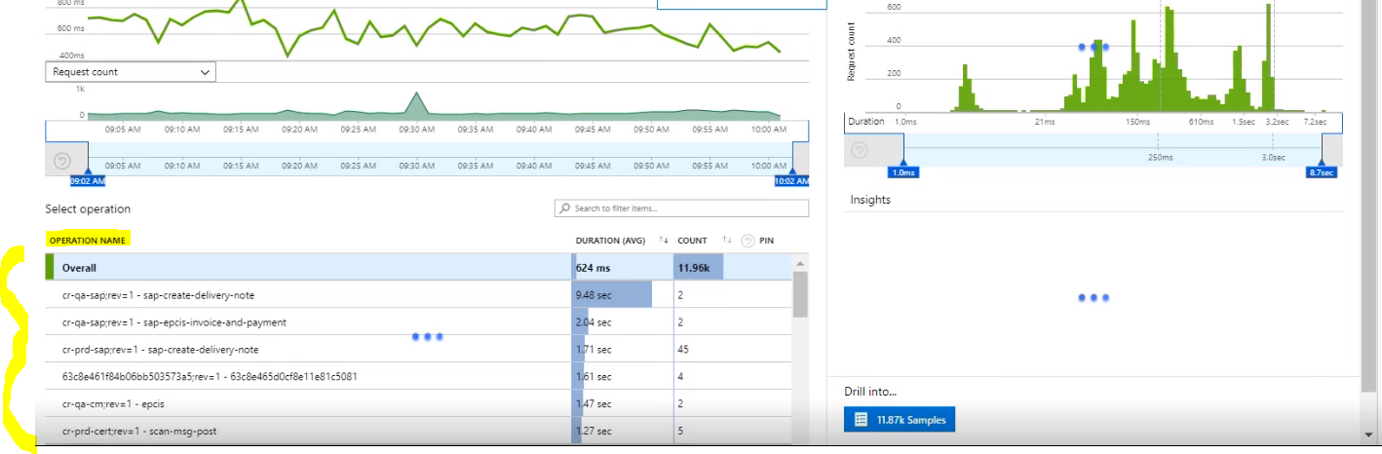
4. Select the required group of the messages and drill down to the content

Slide 12
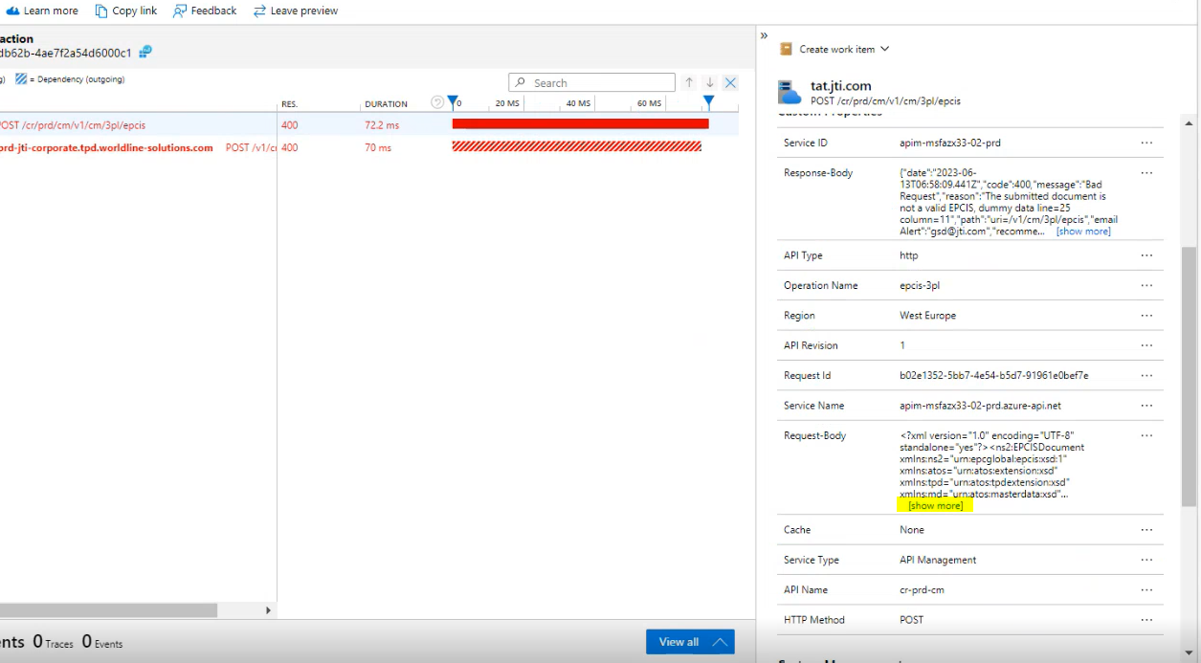
5. Select the required sample and review it's details, including XML-fragment.

Slide 13
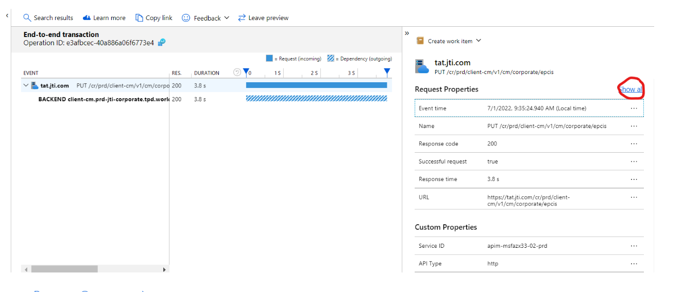
5.1 Select the «Show All» to see details of XML-fragment and sample

Slide 14
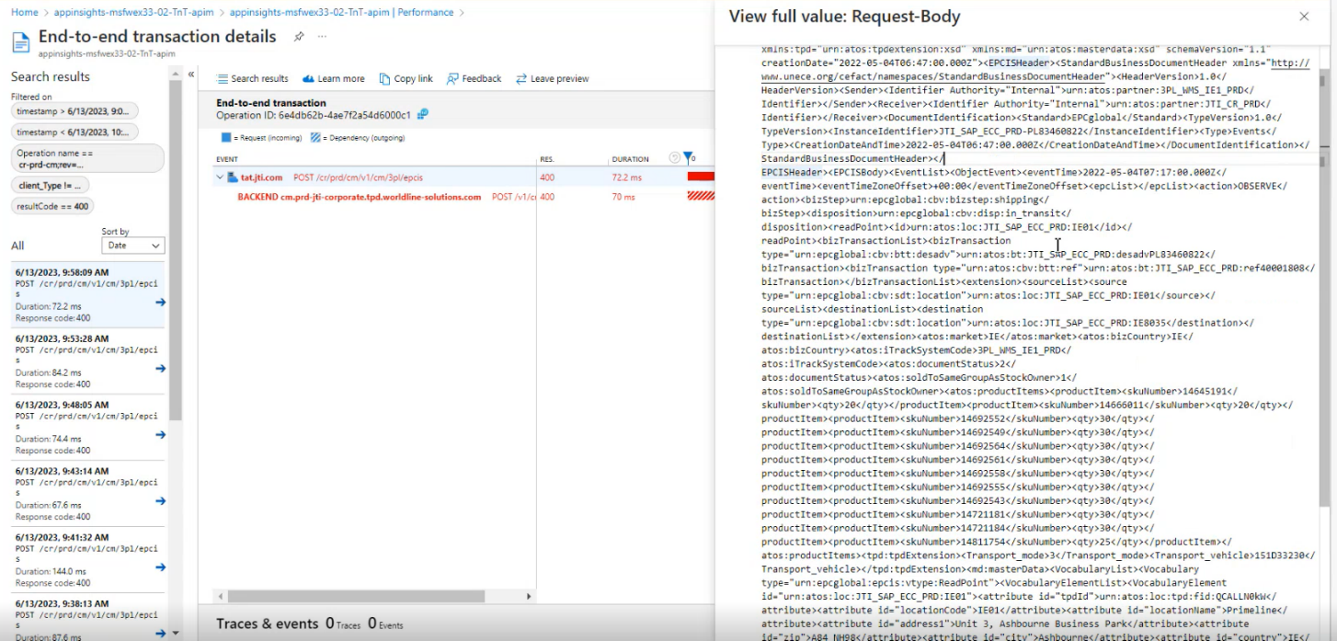

Slide 15
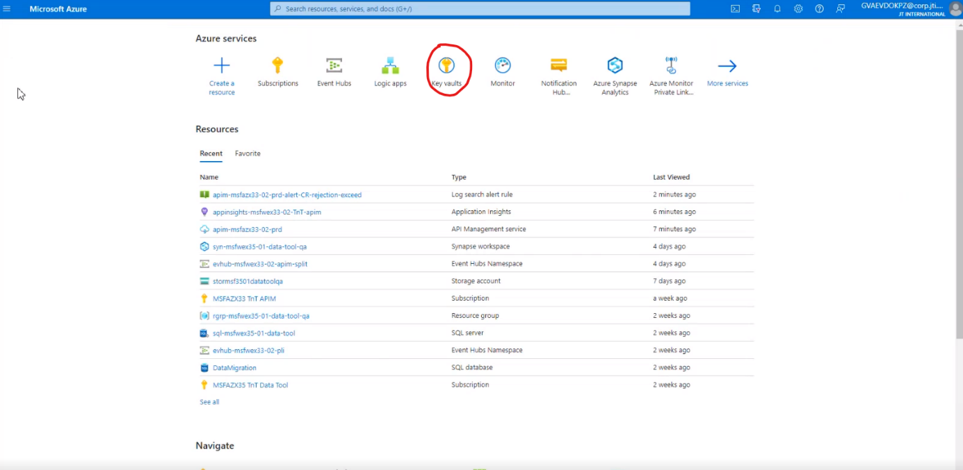
How to create Certificate
1. Select “Key Vaults” section in the menu bar

Slide 16
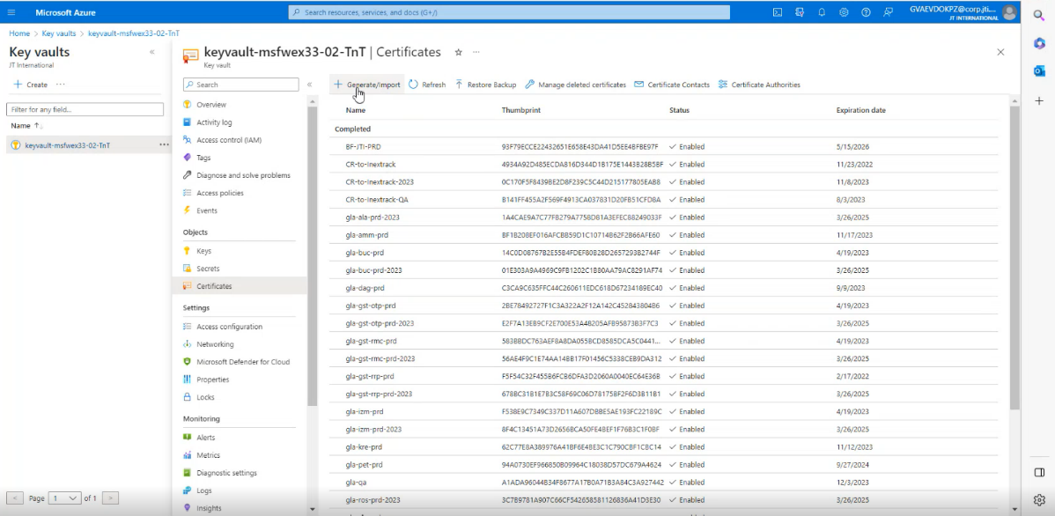
2. Select “Generate/Import” section to start creating new certificate on Azure

Slide 17
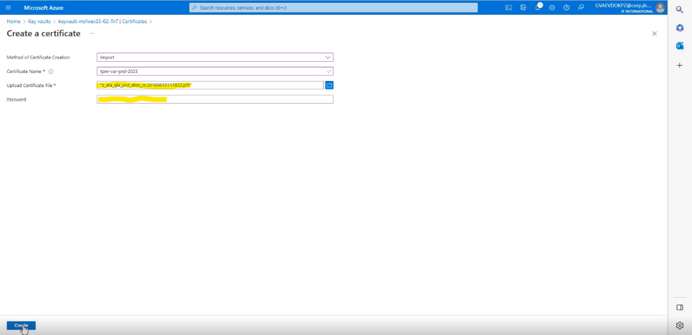
3. Follow the steps and fiil the blank by using existing URL “Certificate Name”

Slide 18
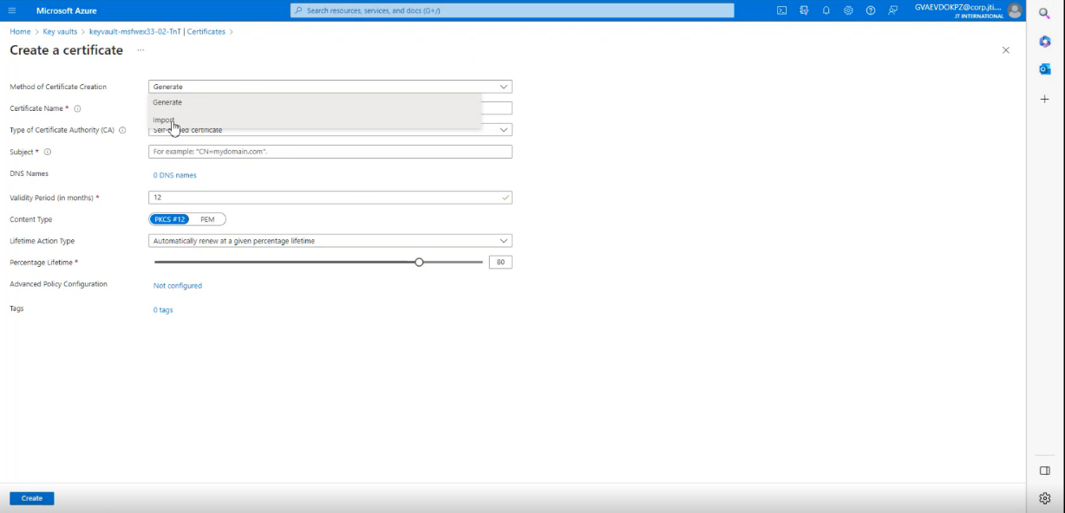

Slide 19
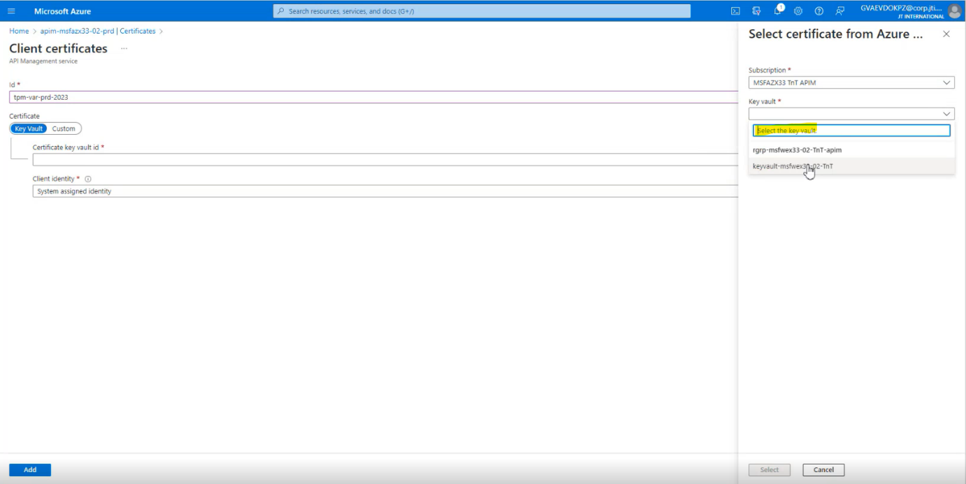
4. Search created the keyvault and select that one then select add button to continue

Slide 20
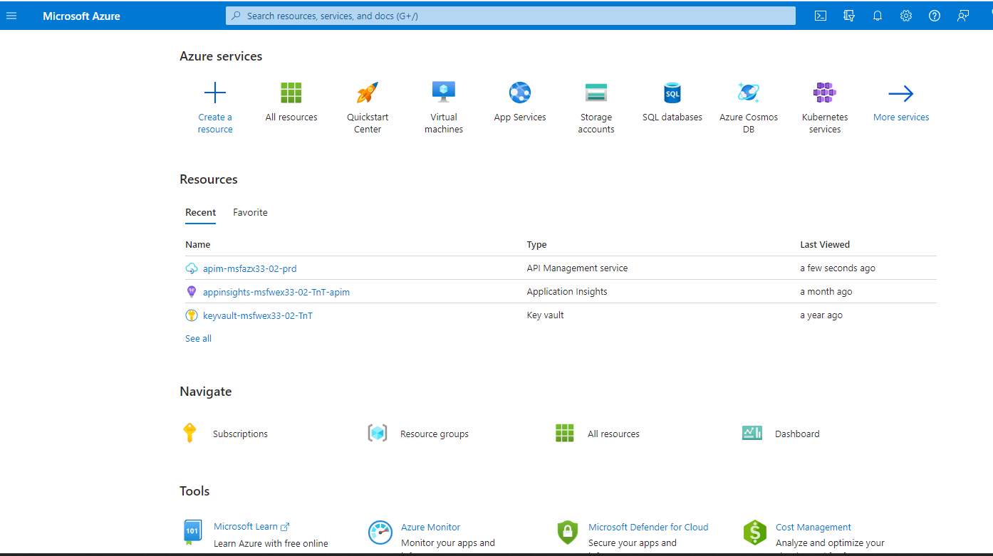
How To Create Endpoint Of APIM ?

Slide 21
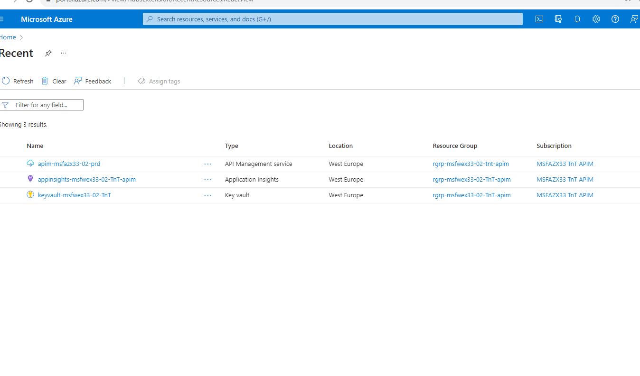
1. Select the name of link below which is «apim-msfazx33-02-prd»

Slide 22
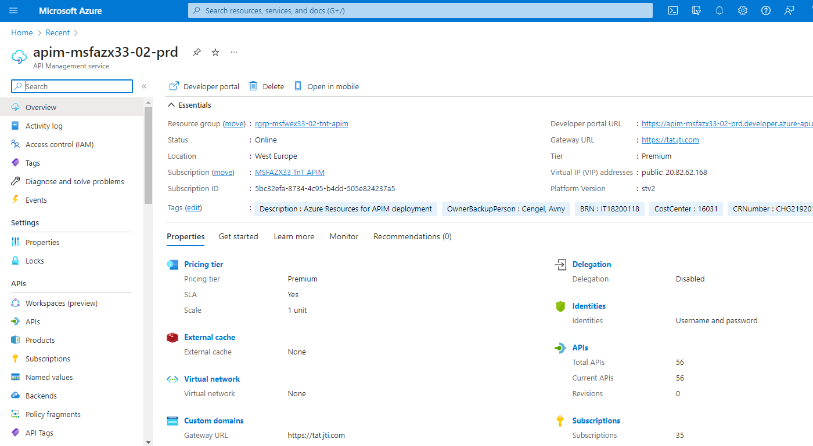
2. You can see server settings and events in detail at that page below

Slide 23
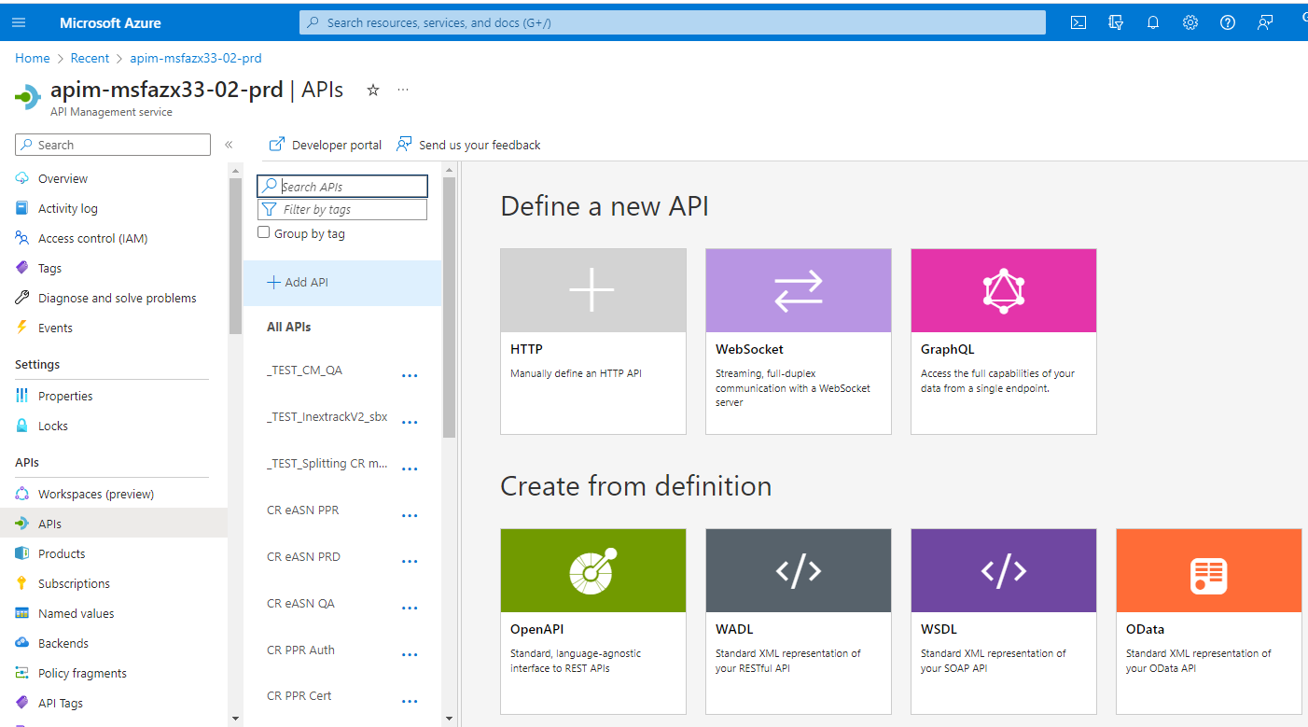
3. You can add and remove endpoints at that page

Slide 24
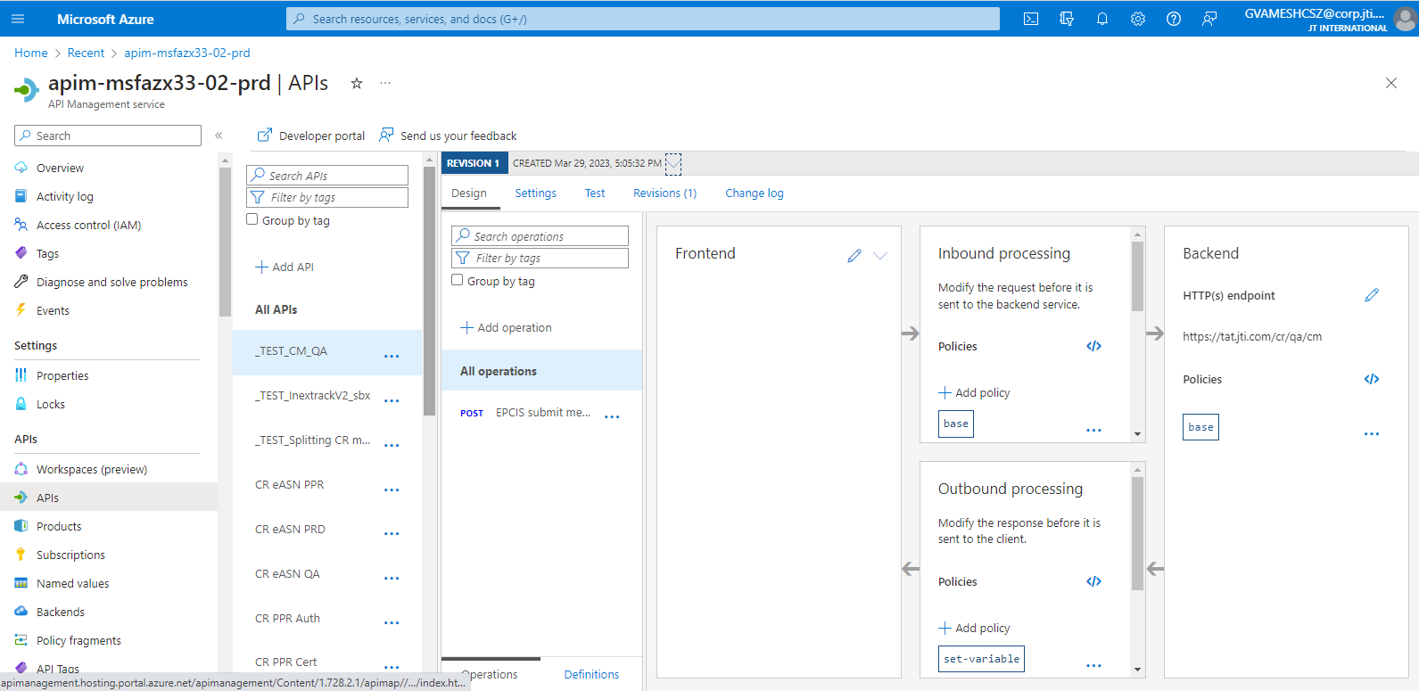
4. You can see endpoint below

Slide 25
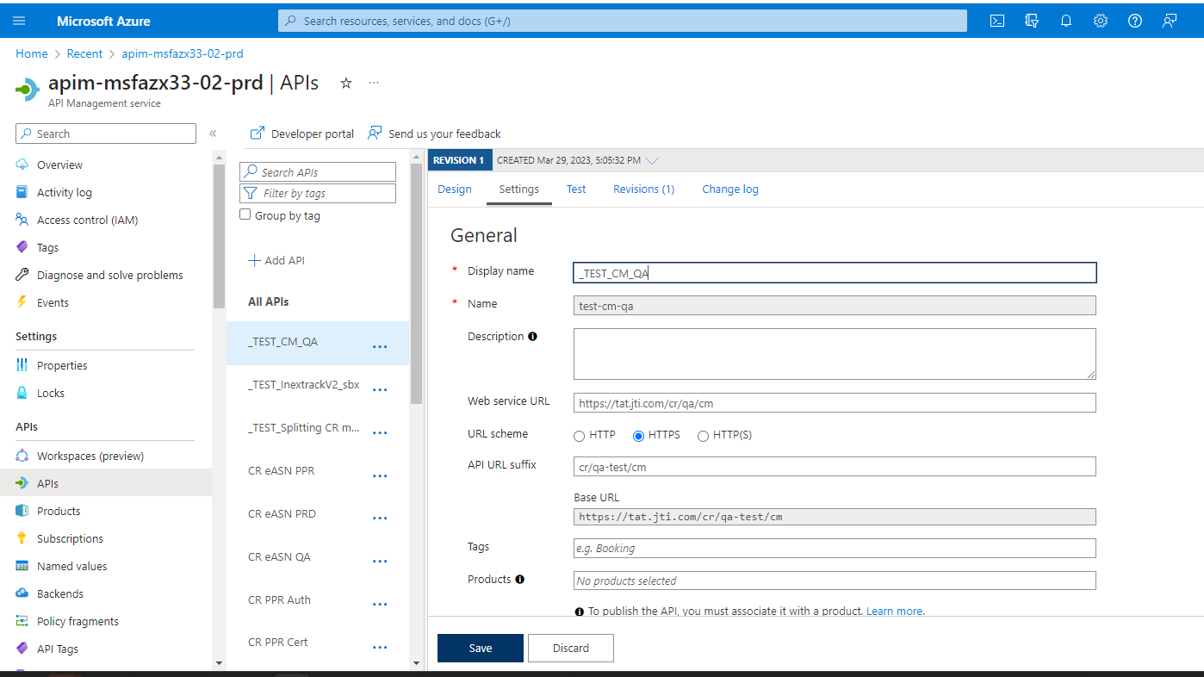
5. You can configure endpoint and set url that is related with platform

Slide 26
Conclusion :
By implementing this proposal, we aim to empower team members with the necessary knowledge and skills to effectively utilize APIM.
The comprehensive documentation and interactive training presentation will serve as valuable resources for both new and existing colleagues, ensuring they can navigate APIM confidently and troubleshoot any issues that may arise.

